Slide 1
Data Analysis
Introduction

Slide 2
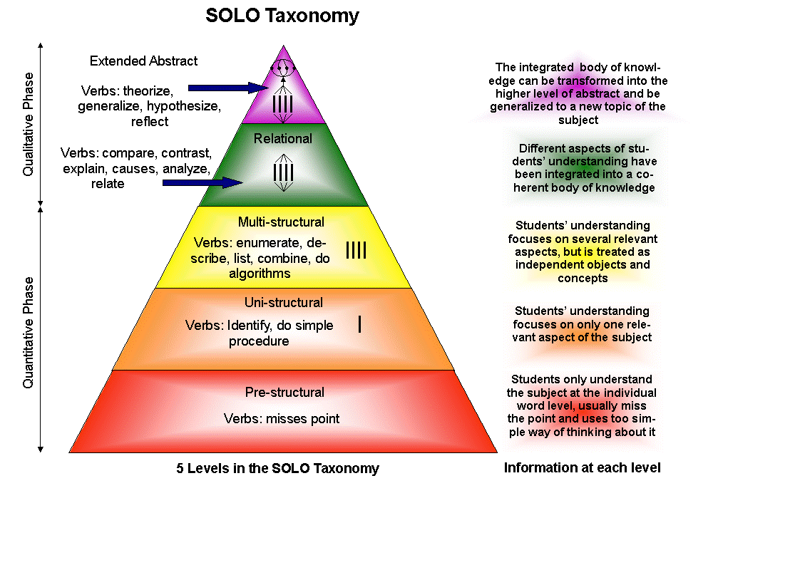
Solo Taxonomy

Slide 3
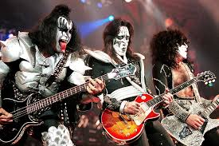
KISS

Slide 4
KISS
Kelly Johnson (Lockhead Matrin)
Keep
It
Simple
Stupid

Slide 5

Leonardo da Vinci
Simplicity is the ultimate sophistication

Slide 6
Experimental Design
Specific Objectives
Not a fishing trip to see what can be found
Supported by theory
Data Types Collected
Parametric and non-parametric
Sample size
Depends on sample variability
Relationships
Differences
Dose response

Slide 7
Data Analysis
Qualitative data
Quantitate data
Mixed methods

Slide 8
Data Analysis
Collect required data
Organise
Summarise
Plot and tabulate
Determine confidence
Describe what it means

Slide 9

More or Less
Take away messages

Slide 10
Data Quality
Poor data in
Poor results out

Slide 11
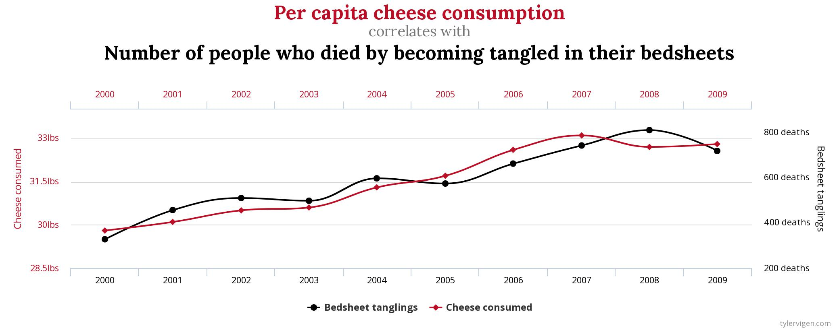
Correlation

Slide 12
Correlation

Slide 13
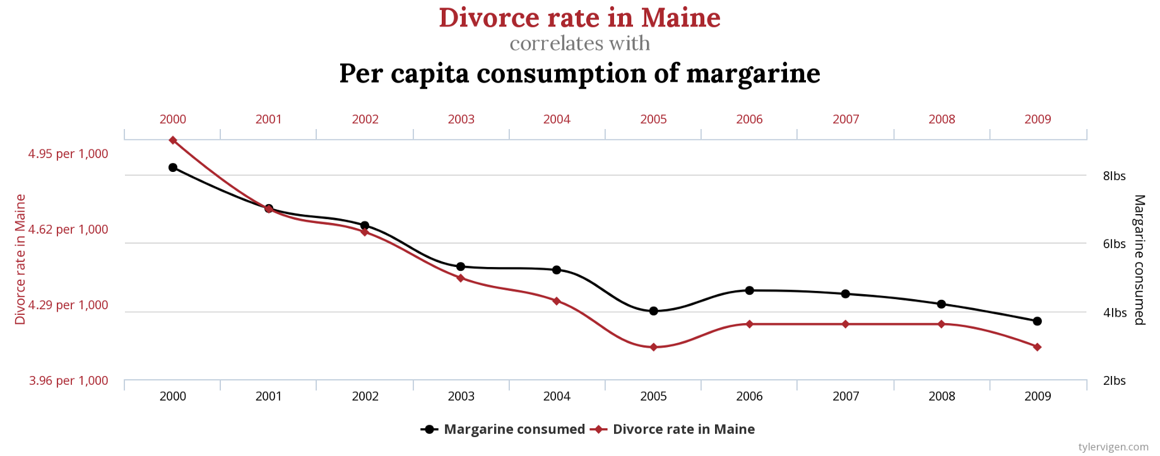
Correlation

Slide 14
Demographics
Age
Gender
Religion
Income
Martial status
Education level
Household size
How many relationships can be investigated?

Slide 15
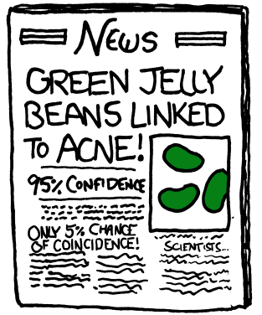
Confidence
Green Jelly beans linked to Acne.

Slide 16
Data Types
Variables
Controlled
Uncontrolled
Dependent
Independent

Slide 17
Data Types
Nominal
Ordinal
Interval
Ratio

Slide 18
Sample size
Objectives
Difference between A and B
Sample size
Variability in data
Size of difference
Confidence level
Availability
Cost

Slide 19
Repeatability
Same result using different technique
Same result different batch
Same result different operator
Same result same process.
Same process - different result

Slide 20
Replication
Increase Confidence
Every stage replicated
New batches of material
Increased sample size

Slide 21
Qualitive
Interviews and focus groups
Transcribe
Identify themes
Highlight range of data
Look for meaning / cause

Slide 22
Quantitate
Collect & Collate
Tabulate
Sort
Describe
Stats
Use of Excel

Slide 23
Raw Data
6 5 2 4 6 3 2 1 4 5
6 2 6 4 1 6 3 5 6 2
1 5 6 4 6 3 5 6 2 6
2 5 6 4 6 1 5 5 6 3
4 6 5 2 6 5 3 4 6 1

Slide 24
Frequency Distribution Table
Number Frequency
1 4
2 6
3 5
4 7
5 10
6 16

Slide 25
Data Summary
Frequency
Relative frequency
Average (Mean or Median)
Standard Deviation or inter-quartile range
Population and Sample

Slide 26
Initial Analysis
Present Data
Bar charts / histograms
Cross tabulations
Scatter charts

Slide 28
Cross Tabulations
Gender Cooks Don’t cook
M 12 8
F 48 80

Slide 29
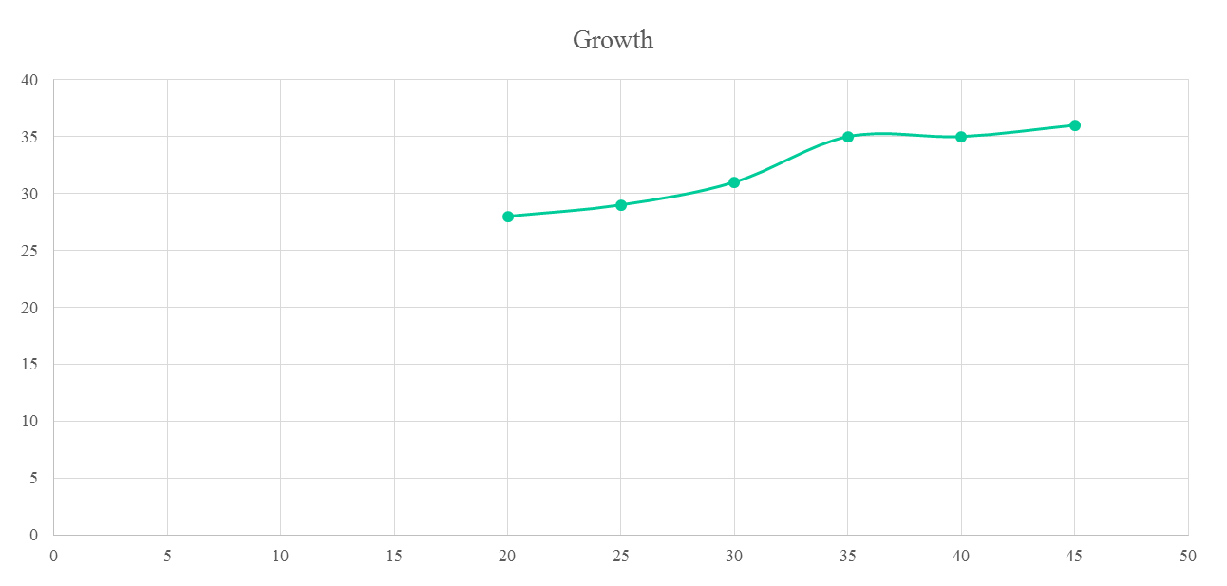
Linear Relationships

Slide 30
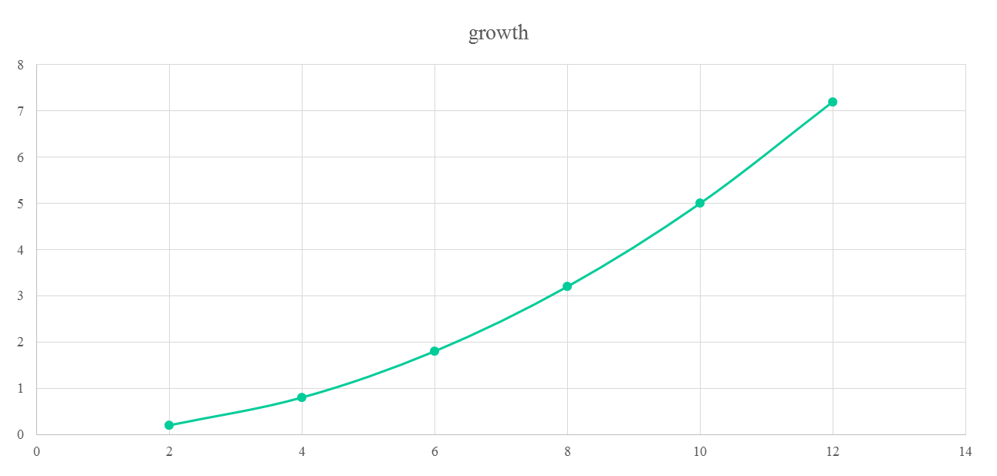
Expodential

Slide 31
Discarding Data
Identify errors in collection
Clearly linked to specific identified errors
Discarding data based on results

Slide 32
Discarding data
4
10
10

Slide 33
2 out of 3 – ain’t bad?
S1 | S2 | S3 | Ave (3) | Ave (2/3)
4 | 10 | 10 | 8.0 | 10
10 | 5 | 7 | 7.3 | 6
6 | 1 | 3 | 3.3 | 2
3 | 9 | 4 | 5.3 | 3.5
9 | 7 | 8 | 8.0 | 8
6 | 6 | 6 | 6.0 | 6
3 | 9 | 10 | 7.3 | 9.5
6 | 1 | 10 | 5.7 | 8
10 | 2 | 7 | 6.3 | 8.5
6 | 7 | 4 | 5.7 | 6.5

Slide 34
Summary
Plan data analysis at experimental design stage
Discard data with extreme care
Organise and summarise data
Plot and tabulate
Explain what the data means

